Slide 1
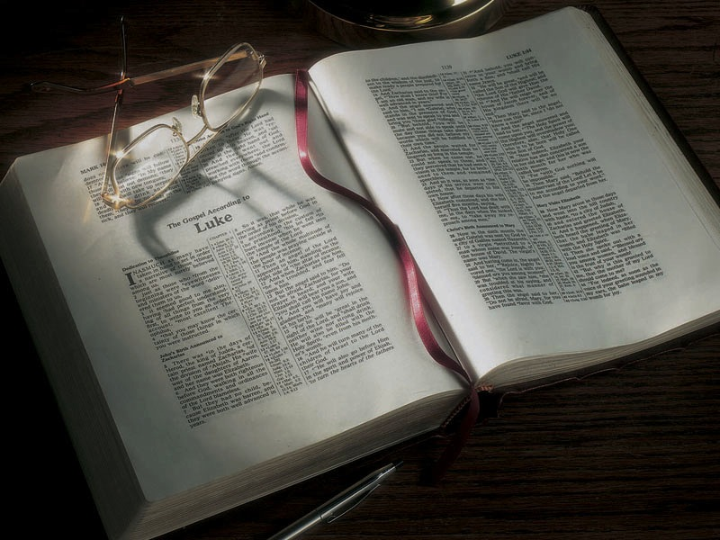

Slide 2
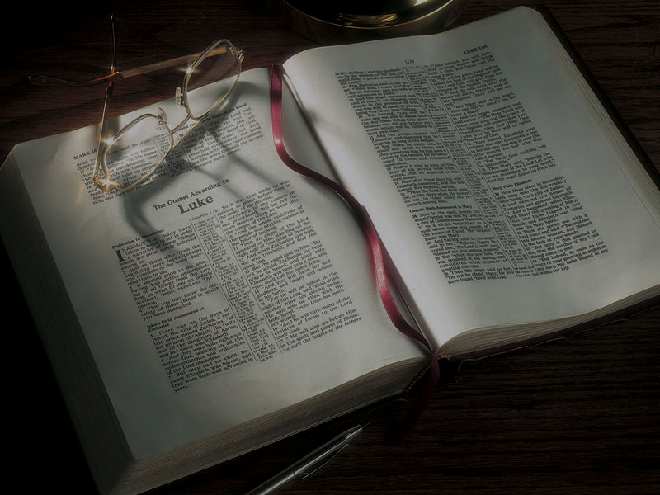
The Gospels
John’s Loyalty, Jesus Leaves Judea,
Meets the Woman at the Well in Samaria

Slide 3
John 3:22-36
22 After these things Jesus and His disciples came into the land of Judea, and there He remained with them and baptized.
23 Now John also was baptizing in Aenon near Salim, because there was much water there. And they came and were baptized.
24 For John had not yet been thrown into prison.
25 Then there arose a dispute between some of John’s disciples and the Jews about purification.

Slide 4
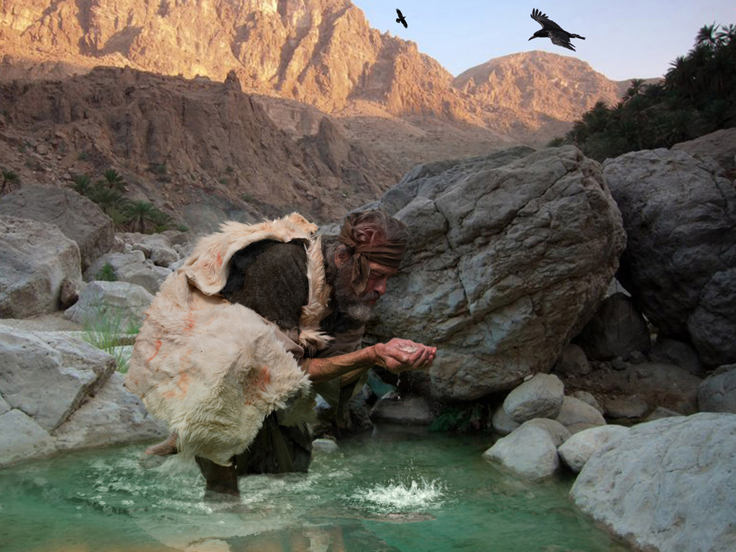

Slide 5
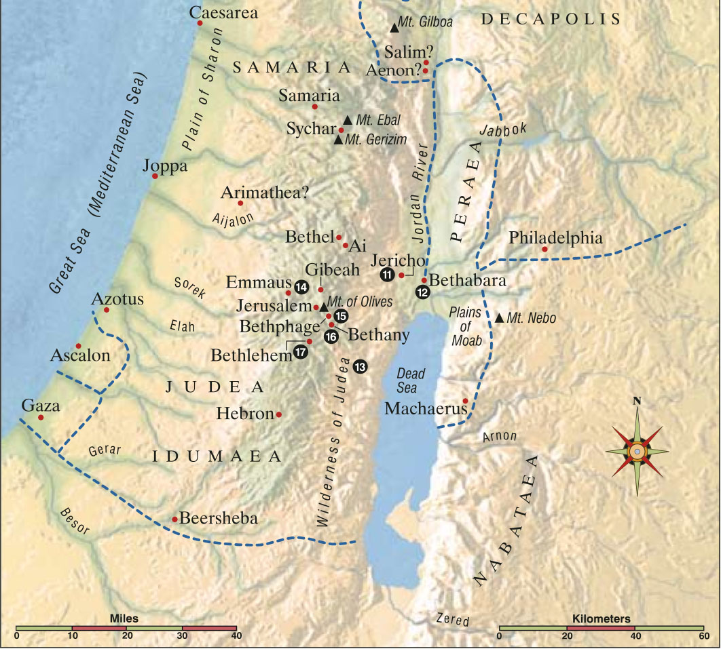

Slide 6
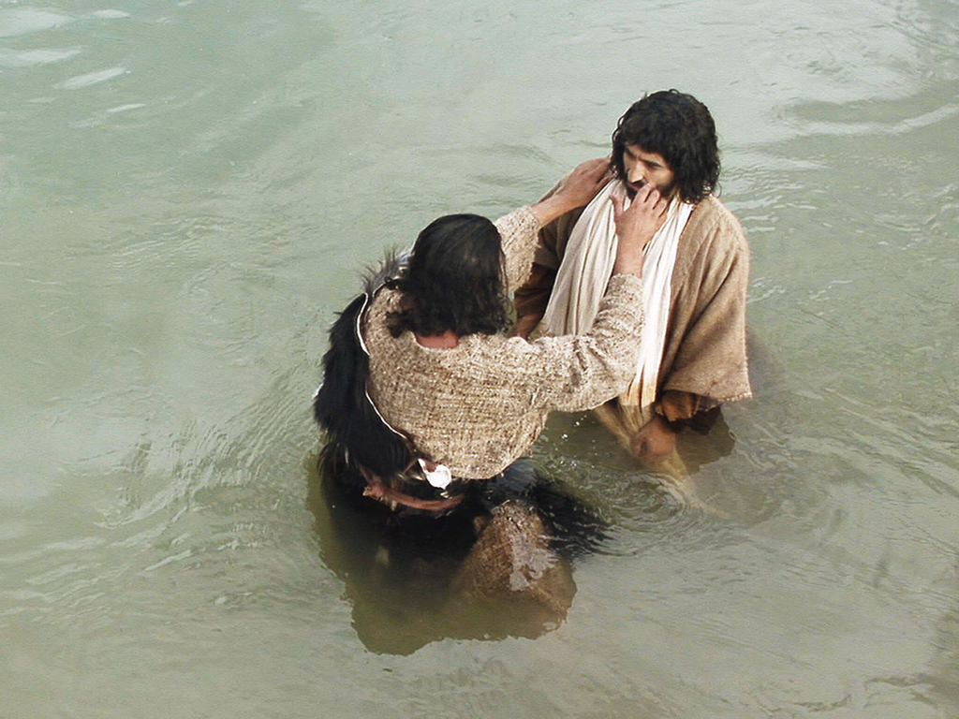

Slide 7
John 3:22-36
22 After these things Jesus and His disciples came into the land of Judea, and there He remained with them and baptized.
23 Now John also was baptizing in Aenon near Salim, because there was much water there. And they came and were baptized.
24 For John had not yet been thrown into prison.
25 Then there arose a dispute between some of John’s disciples and the Jews about purification.

Slide 8
John 3:22-36
22 After these things Jesus and His disciples came into the land of Judea, and there He remained with them and baptized.
23 Now John also was baptizing in Aenon near Salim, because there was much water there. And they came and were baptized.
24 For John had not yet been thrown into prison.
25 Then there arose a dispute between some of John’s disciples and the Jews about purification.
John 2:6; Mark 7:1-13

Slide 9
John 3:22-36
26 And they came to John and said to him, “Rabbi, He who was with you beyond the Jordan, to whom you have testified—behold, He is baptizing, and all are coming to Him!”
27 John answered and said, “A man can receive nothing unless it has been given to him from heaven.
28 “You yourselves bear me witness, that I said, ‘I am not the Christ,’ but, ‘I have been sent before Him.’

Slide 10
John 3:22-36
26 And they came to John and said to him, “Rabbi, He who was with you beyond the Jordan, to whom you have testified—behold, He is baptizing, and all are coming to Him!”
27 John answered and said, “A man can receive nothing unless it has been given to him from heaven.
28 “You yourselves bear me witness, that I said, ‘I am not the Christ,’ but, ‘I have been sent before Him.’
John 1:20-23
29 “He who has the bride is the bridegroom; but the friend of the bridegroom, who stands and hears him, rejoices greatly because of the bridegroom’s voice. Therefore this joy of mine is fulfilled.
30 “He must increase, but I must decrease.
31 “He who comes from above is above all; he who is of the earth is earthly and speaks of the earth. He who comes from heaven is above all.
32 “And what He has seen and heard, that He testifies; and no one receives His testimony.
33 “He who has received His testimony has certified that God is true.
34 “For He whom God has sent speaks the words of God, for God does not give the Spirit by measure.
35 “The Father loves the Son, and has given all things into His hand.
36 “He who believes in the Son has everlasting life; and he who does not believe the Son shall not see life, but the wrath of God abides on him.”
John 4:1-4
4:1 Therefore, when the Lord knew that the Pharisees had heard that Jesus made and baptized more disciples than John
2 (though Jesus Himself did not baptize, but His disciples),
3 He left Judea and departed again to Galilee.
4 But He needed to go through Samaria.
John 4:5-42
5 So He came to a city of Samaria which is called Sychar, near the plot of ground that Jacob gave to his son Joseph.
6 Now Jacob’s well was there. Jesus therefore, being wearied from His journey, sat thus by the well. It was about the sixth hour.
7 A woman of Samaria came to draw water. Jesus said to her, “Give Me a drink.”
8 For His disciples had gone away into the city to buy food.
9 Then the woman of Samaria said to Him, “How is it that You, being a Jew, ask a drink from me, a Samaritan woman?” For Jews have no dealings with Samaritans.
10 Jesus answered and said to her, “If you knew the gift of God, and who it is who says to you, ‘Give Me a drink,’ you would have asked Him, and He would have given you living water.”
11 The woman said to Him, “Sir, You have nothing to draw with, and the well is deep. Where then do You get that living water?
12 “Are You greater than our father Jacob, who gave us the well, and drank from it himself, as well as his sons and his livestock?”
13 Jesus answered and said to her, “Whoever drinks of this water will thirst again,
14 “but whoever drinks of the water that I shall give him will never thirst. But the water that I shall give him will become in him a fountain of water springing up into everlasting life.”
15 The woman said to Him, “Sir, give me this water, that I may not thirst, nor come here to draw.”
16 Jesus said to her, “Go, call your husband, and come here.”
17 The woman answered and said, “I have no husband.” Jesus said to her, “You have well said, ‘I have no husband,’
18 “for you have had five husbands, and the one whom you now have is not your husband; in that you spoke truly.”
19 The woman said to Him, “Sir, I perceive that You are a prophet.
20 “Our fathers worshiped on this mountain, and you Jews say that in Jerusalem is the place where one ought to worship.”
21 Jesus said to her, “Woman, believe Me, the hour is coming when you will neither on this mountain, nor in Jerusalem, worship the Father.
22 “You worship what you do not know; we know what we worship, for salvation is of the Jews.
23 “But the hour is coming, and now is, when the true worshipers will worship the Father in spirit and truth; for the Father is seeking such to worship Him.
24 “God is Spirit, and those who worship Him must worship in spirit and truth.”
25 The woman said to Him, “I know that Messiah is coming” (who is called Christ). “When He comes, He will tell us all things.”
26 Jesus said to her, “I who speak to you am He.”
27 And at this point His disciples came, and they marveled that He talked with a woman; yet no one said, “What do You seek?” or, “Why are You talking with her?”
28 The woman then left her waterpot, went her way into the city, and said to the men,
29 “Come, see a Man who told me all things that I ever did. Could this be the Christ?”
30 Then they went out of the city and came to Him.
31 In the meantime His disciples urged Him, saying, “Rabbi, eat.”
32 But He said to them, “I have food to eat of which you do not know.”
33 Therefore the disciples said to one another, “Has anyone brought Him anything to eat?”
34 Jesus said to them, “My food is to do the will of Him who sent Me, and to finish His work.
35 “Do you not say, ‘There are still four months and then comes the harvest’? Behold, I say to you, lift up your eyes and look at the fields, for they are already white for harvest!
36 “And he who reaps receives wages, and gathers fruit for eternal life, that both he who sows and he who reaps may rejoice together.
37 “For in this the saying is true: ‘One sows and another reaps.’
38 “I sent you to reap that for which you have not labored; others have labored, and you have entered into their labors.”
39 And many of the Samaritans of that city believed in Him because of the word of the woman who testified, “He told me all that I ever did.”
40 So when the Samaritans had come to Him, they urged Him to stay with them; and He stayed there two days.
41 And many more believed because of His own word.
42 Then they said to the woman, “Now we believe, not because of what you said, for we ourselves have heard Him and we know that this is indeed the Christ, the Savior of the world.”

Slide 11
John 3:22-36
29 “He who has the bride is the bridegroom; but the friend of the bridegroom, who stands and hears him, rejoices greatly because of the bridegroom’s voice. Therefore this joy of mine is fulfilled.
30 “He must increase, but I must decrease.
31 “He who comes from above is above all; he who is of the earth is earthly and speaks of the earth. He who comes from heaven is above all.
32 “And what He has seen and heard, that He testifies; and no one receives His testimony.

Slide 12
John 3:22-36
33 “He who has received His testimony has certified that God is true.
34 “For He whom God has sent speaks the words of God, for God does not give the Spirit by measure.
NIV: for God gives the Spirit without limit.
35 “The Father loves the Son, and has given all things into His hand.
36 “He who believes in the Son has everlasting life; and he who does not believe the Son shall not see life, but the wrath of God abides on him.”

Slide 13
Philippians 2:9-11
9 Therefore God also has highly exalted Him and given Him the name which is above every name,
10 that at the name of Jesus every knee should bow, of those in heaven, and of those on earth, and of those under the earth,
11 and that every tongue should confess that Jesus Christ is Lord, to the glory of God the Father.

Slide 14
John 3:22-36
33 “He who has received His testimony has certified that God is true.
34 “For He whom God has sent speaks the words of God, for God does not give the Spirit by measure.
NIV: for God gives the Spirit without limit.
35 “The Father loves the Son, and has given all things into His hand.
36 “He who believes in the Son has everlasting life; and he who does not believe the Son shall not see life, but the wrath of God abides on him.”

Slide 15
John 4:1-4
4:1 Therefore, when the Lord knew that the Pharisees had heard that Jesus made and baptized more disciples than John
2 (though Jesus Himself did not baptize, but His disciples),
3 He left Judea and departed again to Galilee.
4 But He needed to go through Samaria.

Slide 16
Luke 3:19-20
19 But Herod the tetrarch, being rebuked by him concerning Herodias, his brother Philip’s wife, and for all the evils which Herod had done,
20 also added this, above all, that he shut John up in prison.

Slide 17
Luke 3:19-20
19 But Herod the tetrarch, being rebuked by him concerning Herodias, his brother Philip’s wife, and for all the evils which Herod had done,
20 also added this, above all, that he shut John up in prison.
Matthew 4:12
12 Now when Jesus heard that John had been put in prison, He departed to Galilee.

Slide 18
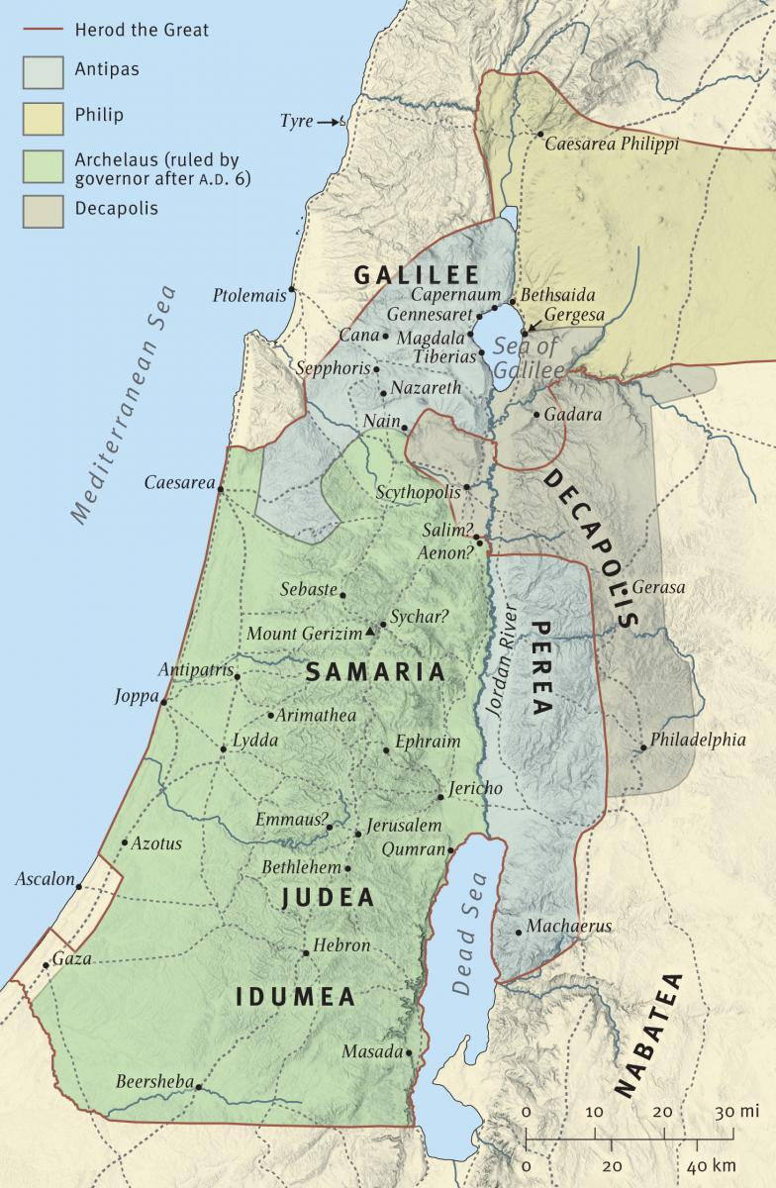

Slide 19
Mark 1:14
14 Now after John was put in prison, Jesus came to Galilee, preaching the gospel of the kingdom of God,

Slide 20
Mark 1:14
14 Now after John was put in prison, Jesus came to Galilee, preaching the gospel of the kingdom of God,
Luke 4:14
14 Then Jesus returned in the power of the Spirit to Galilee, and news of Him went out through all the surrounding region.

Slide 21
John 4:5-42
5 So He came to a city of Samaria which is called Sychar, near the plot of ground that Jacob gave to his son Joseph.

Slide 23
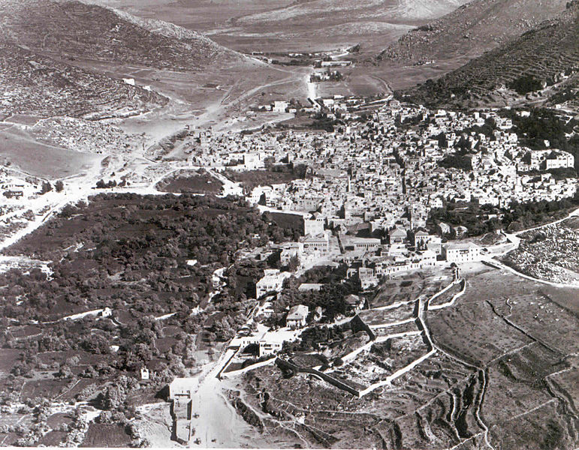

Slide 24
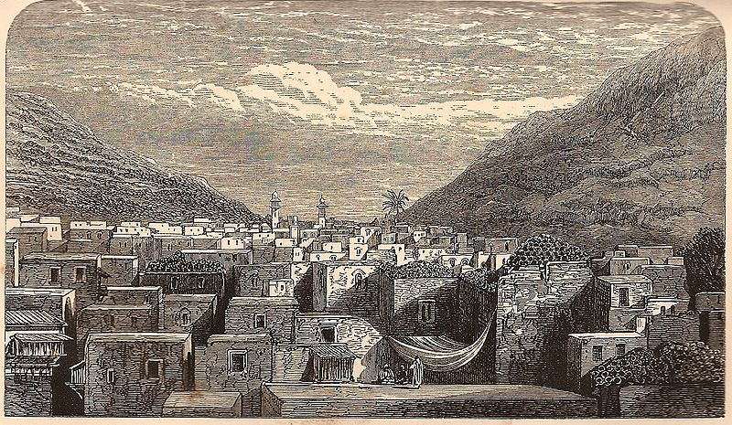

Slide 25
Shechem in biblical history:

Slide 26
Shechem in biblical history:
• Abraham built an altar and was promised the land there (Genesis 12:6-7)

Slide 27
Shechem in biblical history:
• Abraham built an altar and was promised the land there (Genesis 12:6-7)
• Jacob (Israel) lived and built an altar there (Genesis 33:18-20)

Slide 28
Shechem in biblical history:
• Abraham built an altar and was promised the land there (Genesis 12:6-7)
• Jacob (Israel) lived and built an altar there (Genesis 33:18-20)
• Simeon and Levi killed the men of Shechem after Dinah was raped (Genesis 34)

Slide 29
Shechem in biblical history:
• Abraham built an altar and was promised the land there (Genesis 12:6-7)
• Jacob (Israel) lived and built an altar there (Genesis 33:18-20)
• Simeon and Levi killed the men of Shechem after Dinah was raped (Genesis 34)
• Joseph came to Shechem looking for his brothers and they sold him not far from there (Genesis 37)

Slide 30
Shechem in biblical history:
• Joseph’s bones were taken from Egypt and buried at Shechem (Joshua 24:32)

Slide 31
Shechem in biblical history:
• Joseph’s bones were taken from Egypt and buried at Shechem (Joshua 24:32)
• The Israelites shouted the blessings and cursings from Mt. Ebal and Gerazim there (Deuteronomy 27:11-26; Joshua 8:33-35)

Slide 32
Shechem in biblical history:
• Joseph’s bones were taken from Egypt and buried at Shechem (Joshua 24:32)
• The Israelites shouted the blessings and cursings from Mt. Ebal and Gerazim there (Deuteronomy 27:11-26; Joshua 8:33-35)
• Joshua gave his last words to Israel there (Joshua 24)

Slide 33
Shechem in biblical history:
• Joseph’s bones were taken from Egypt and buried at Shechem (Joshua 24:32)
• The Israelites shouted the blessings and cursings from Mt. Ebal and Gerazim there (Deuteronomy 27:11-26; Joshua 8:33-35)
• Joshua gave his last words to Israel there (Joshua 24)
• Shechem became the first capital of Jeroboam and the northern 10 tribes (1 Kings 12:25)

Slide 35
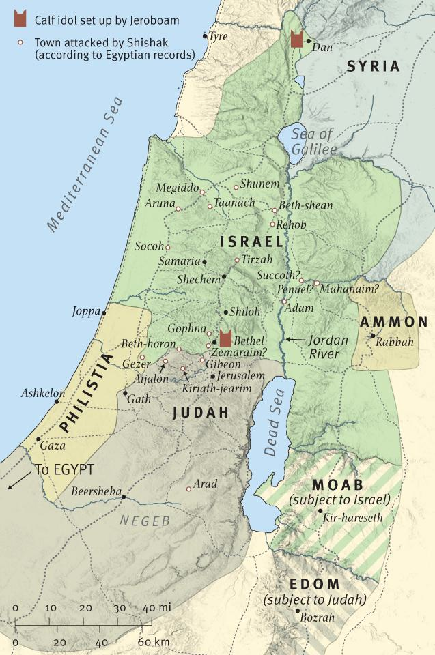

Slide 36
2 Kings 17:5-24
5 Now the king of Assyria went throughout all the land, and went up to Samaria and besieged it for three years.
6 In the ninth year of Hoshea, the king of Assyria took Samaria and carried Israel away to Assyria, and placed them in Halah and by the Habor, the River of Gozan, and in the cities of the Medes.
7 For so it was that the children of Israel had sinned against the LORD their God . . . and they had feared other gods . . .

Slide 37
2 Kings 17:5-24
22 For the children of Israel walked in all the sins of Jeroboam which he did; they did not depart from them,
23 until the LORD removed Israel out of His sight, as He had said by all His servants the prophets. So Israel was carried away from their own land to Assyria, as it is to this day.

Slide 38
2 Kings 17:5-24
24 Then the king of Assyria brought people from Babylon, Cuthah, Ava, Hamath, and from Sepharvaim, and placed them in the cities of Samaria instead of the children of Israel; and they took possession of Samaria and dwelt in its cities.

Slide 39
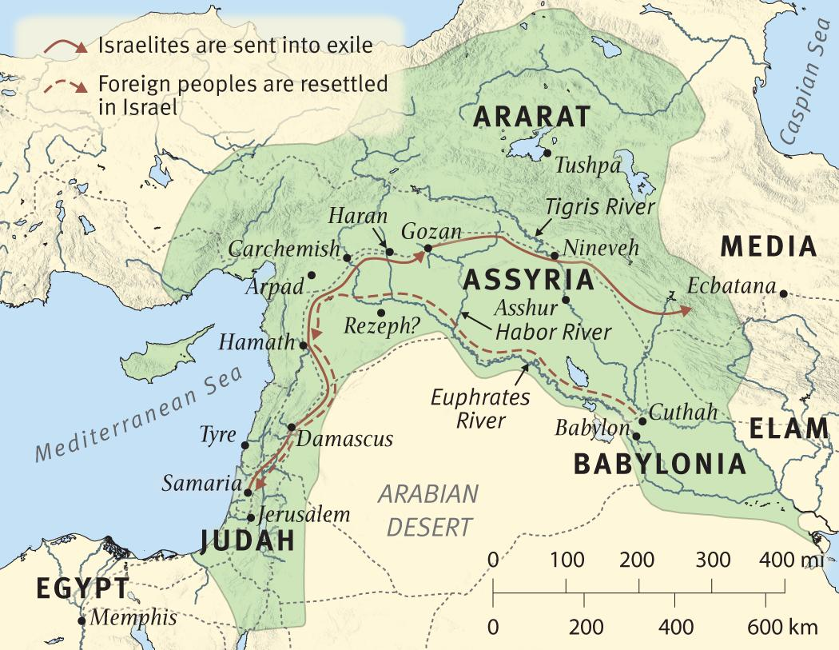

Slide 40
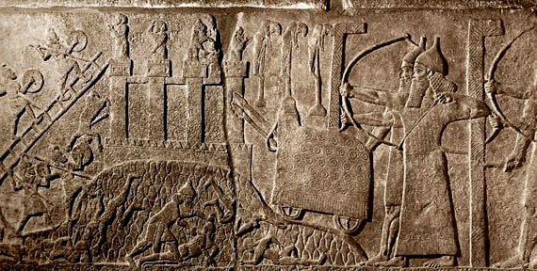

Slide 41
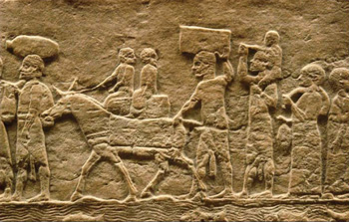

Slide 42
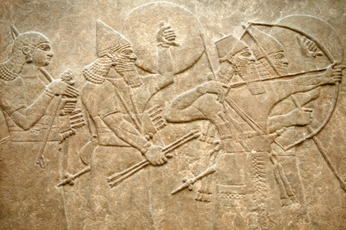

Slide 43
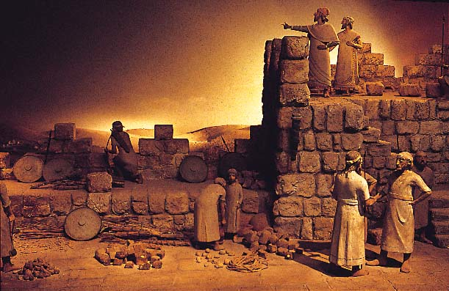

Slide 44
John 4:5-42
5 So He came to a city of Samaria which is called Sychar, near the plot of ground that Jacob gave to his son Joseph.
6 Now Jacob’s well was there. Jesus therefore, being wearied from His journey, sat thus by the well. It was about the sixth hour.
7 A woman of Samaria came to draw water. Jesus said to her, “Give Me a drink.”
8 For His disciples had gone away into the city to buy food.

Slide 45
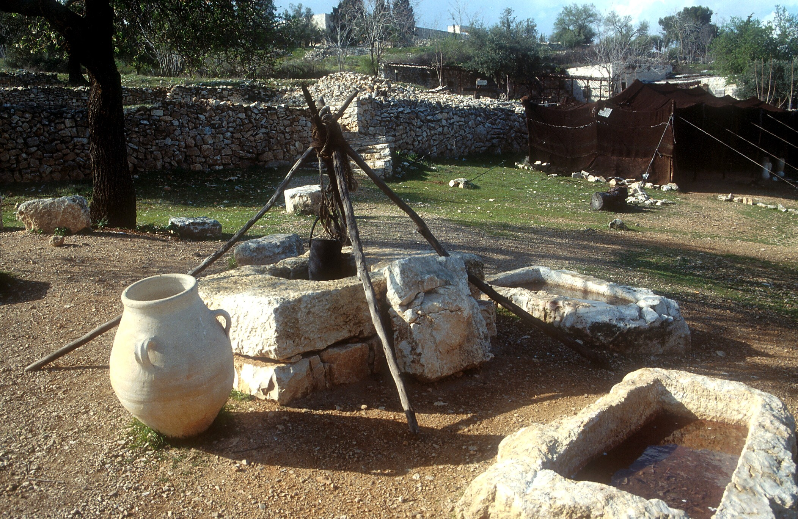

Slide 46
John 4:5-42
5 So He came to a city of Samaria which is called Sychar, near the plot of ground that Jacob gave to his son Joseph.
6 Now Jacob’s well was there. Jesus therefore, being wearied from His journey, sat thus by the well. It was about the sixth hour.
7 A woman of Samaria came to draw water. Jesus said to her, “Give Me a drink.”
8 For His disciples had gone away into the city to buy food.

Slide 47
John 4:5-42
9 Then the woman of Samaria said to Him, “How is it that You, being a Jew, ask a drink from me, a Samaritan woman?” For Jews have no dealings with Samaritans.
10 Jesus answered and said to her, “If you knew the gift of God, and who it is who says to you, ‘Give Me a drink,’ you would have asked Him, and He would have given you living water.”

Slide 48
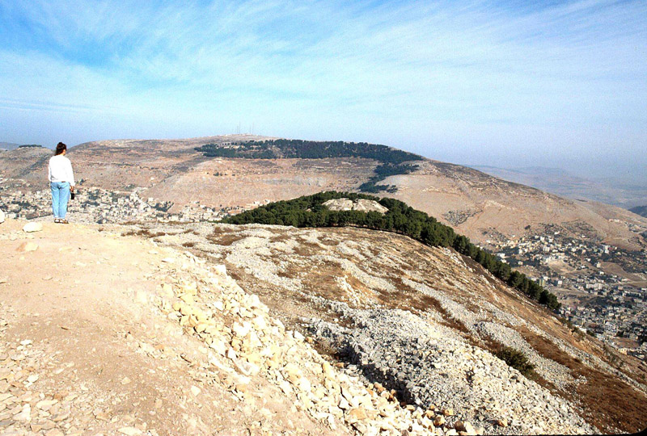

Slide 49
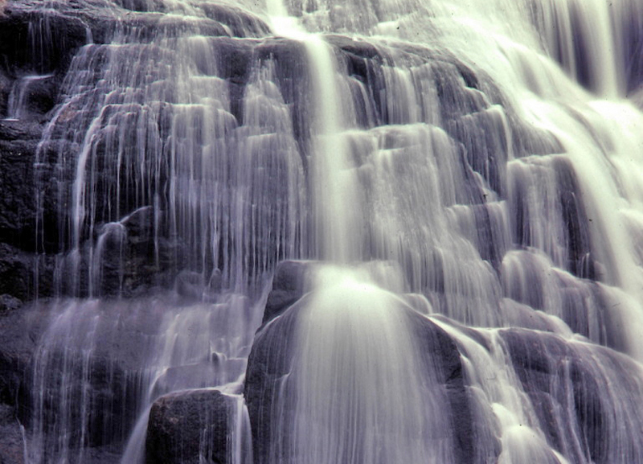

Slide 50
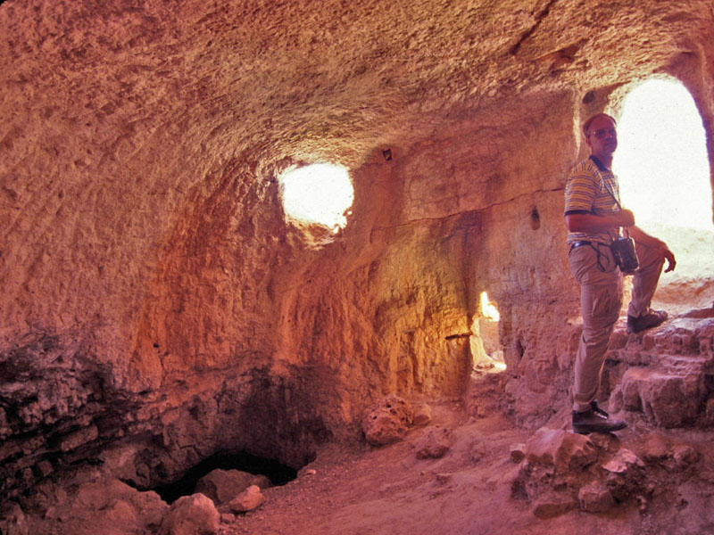

Slide 51
Jeremiah 2:13
13 For My people have committed two evils: They have forsaken Me, the fountain of living waters, and hewn themselves cisterns—broken cisterns that can hold no water.

Slide 52
John 4:5-42
11 The woman said to Him, “Sir, You have nothing to draw with, and the well is deep. Where then do You get that living water?
12 “Are You greater than our father Jacob, who gave us the well, and drank from it himself, as well as his sons and his livestock?”

Slide 53
John 4:5-42
13 Jesus answered and said to her, “Whoever drinks of this water will thirst again,
14 “but whoever drinks of the water that I shall give him will never thirst. But the water that I shall give him will become in him a fountain of water springing up into everlasting life.”

Slide 54
Jeremiah 2:13
13 For My people have committed two evils: They have forsaken Me, the fountain of living waters, and hewn themselves cisterns—broken cisterns that can hold no water.

Slide 55
John 4:5-42
15 The woman said to Him, “Sir, give me this water, that I may not thirst, nor come here to draw.”
16 Jesus said to her, “Go, call your husband, and come here.”
17 The woman answered and said, “I have no husband.” Jesus said to her, “You have well said, ‘I have no husband,’
18 “for you have had five husbands, and the one whom you now have is not your husband; in that you spoke truly.”

Slide 56
John 4:5-42
19 The woman said to Him, “Sir, I perceive that You are a prophet.
20 “Our fathers worshiped on this mountain, and you Jews say that in Jerusalem is the place where one ought to worship.”
21 Jesus said to her, “Woman, believe Me, the hour is coming when you will neither on this mountain, nor in Jerusalem, worship the Father.
22 “You worship what you do not know; we know what we worship, for salvation is of the Jews.

Slide 57
John 4:5-42
23 “But the hour is coming, and now is, when the true worshipers will worship the Father in spirit and truth; for the Father is seeking such to worship Him.
24 “God is Spirit, and those who worship Him must worship in spirit and truth.”

Slide 58
Psalm 51:17
17 The sacrifices of God are a broken spirit, a broken and a contrite heart—these, O God, You will not despise.

Slide 59
Romans 12:1-2
1 I beseech you therefore, brethren, by the mercies of God, that you present your bodies a living sacrifice, holy, acceptable to God, which is your reasonable service.
2 And do not be conformed to this world, but be transformed by the renewing of your mind, that you may prove what is that good and acceptable and perfect will of God.

Slide 60
Hebrews 13:6
6 But do not forget to do good and to share, for with such sacrifices God is well pleased.

Slide 61
Mark 12:33
33 And to love Him with all the heart, with all the understanding, with all the soul, and with all the strength, and to love one’s neighbor as oneself, is more than all the whole burnt offerings and sacrifices.

Slide 62
How we worship God in spirit and in truth:
• By having a humble and converted spirit.
• By having our minds transformed to become like Jesus Christ.
• By sacrificing our lives in service to God and others.
• By loving God with all our heart, soul, mind and strength and loving others as we do ourselves.

Slide 63
John 4:5-42
25 The woman said to Him, “I know that Messiah is coming” (who is called Christ). “When He comes, He will tell us all things.”
26 Jesus said to her, “I who speak to you am He.”
27 And at this point His disciples came, and they marveled that He talked with a woman; yet no one said, “What do You seek?” or, “Why are You talking with her?”

Slide 64
John 4:5-42
28 The woman then left her waterpot, went her way into the city, and said to the men,
29 “Come, see a Man who told me all things that I ever did. Could this be the Christ?”
30 Then they went out of the city and came to Him.
31 In the meantime His disciples urged Him, saying, “Rabbi, eat.”
32 But He said to them, “I have food to eat of which you do not know.”

Slide 65
John 4:5-42
33 Therefore the disciples said to one another, “Has anyone brought Him anything to eat?”
34 Jesus said to them, “My food is to do the will of Him who sent Me, and to finish His work.
35 “Do you not say, ‘There are still four months and then comes the harvest’? Behold, I say to you, lift up your eyes and look at the fields, for they are already white for harvest!

Slide 66
John 4:5-42
36 “And he who reaps receives wages, and gathers fruit for eternal life, that both he who sows and he who reaps may rejoice together.
37 “For in this the saying is true: ‘One sows and another reaps.’
38 “I sent you to reap that for which you have not labored; others have labored, and you have entered into their labors.”

Slide 67
John 4:5-42
39 And many of the Samaritans of that city believed in Him because of the word of the woman who testified, “He told me all that I ever did.”
40 So when the Samaritans had come to Him, they urged Him to stay with them; and He stayed there two days.

Slide 68
John 4:5-42
41 And many more believed because of His own word.
42 Then they said to the woman, “Now we believe, not because of what you said, for we ourselves have heard Him and we know that this is indeed the Christ, the Savior of the world.”

Slide 71
John 4:5-42
5 So He came to a city of Samaria which is called Sychar, near the plot of ground that Jacob gave to his son Joseph.
6 Now Jacob’s well was there. Jesus therefore, being wearied from His journey, sat thus by the well. It was about the sixth hour.
7 A woman of Samaria came to draw water. Jesus said to her, “Give Me a drink.”
8 For His disciples had gone away into the city to buy food.
9 Then the woman of Samaria said to Him, “How is it that You, being a Jew, ask a drink from me, a Samaritan woman?” For Jews have no dealings with Samaritans.
10 Jesus answered and said to her, “If you knew the gift of God, and who it is who says to you, ‘Give Me a drink,’ you would have asked Him, and He would have given you living water.”
11 The woman said to Him, “Sir, You have nothing to draw with, and the well is deep. Where then do You get that living water?
12 “Are You greater than our father Jacob, who gave us the well, and drank from it himself, as well as his sons and his livestock?”
13 Jesus answered and said to her, “Whoever drinks of this water will thirst again,
14 “but whoever drinks of the water that I shall give him will never thirst. But the water that I shall give him will become in him a fountain of water springing up into everlasting life.”
15 The woman said to Him, “Sir, give me this water, that I may not thirst, nor come here to draw.”
16 Jesus said to her, “Go, call your husband, and come here.”
17 The woman answered and said, “I have no husband.” Jesus said to her, “You have well said, ‘I have no husband,’
18 “for you have had five husbands, and the one whom you now have is not your husband; in that you spoke truly.”
19 The woman said to Him, “Sir, I perceive that You are a prophet.
20 “Our fathers worshiped on this mountain, and you Jews say that in Jerusalem is the place where one ought to worship.”
21 Jesus said to her, “Woman, believe Me, the hour is coming when you will neither on this mountain, nor in Jerusalem, worship the Father.
22 “You worship what you do not know; we know what we worship, for salvation is of the Jews.
23 “But the hour is coming, and now is, when the true worshipers will worship the Father in spirit and truth; for the Father is seeking such to worship Him.
24 “God is Spirit, and those who worship Him must worship in spirit and truth.”
25 The woman said to Him, “I know that Messiah is coming” (who is called Christ). “When He comes, He will tell us all things.”
26 Jesus said to her, “I who speak to you am He.”
27 And at this point His disciples came, and they marveled that He talked with a woman; yet no one said, “What do You seek?” or, “Why are You talking with her?”
28 The woman then left her waterpot, went her way into the city, and said to the men,
29 “Come, see a Man who told me all things that I ever did. Could this be the Christ?”
30 Then they went out of the city and came to Him.
31 In the meantime His disciples urged Him, saying, “Rabbi, eat.”
32 But He said to them, “I have food to eat of which you do not know.”
33 Therefore the disciples said to one another, “Has anyone brought Him anything to eat?”
34 Jesus said to them, “My food is to do the will of Him who sent Me, and to finish His work.
35 “Do you not say, ‘There are still four months and then comes the harvest’? Behold, I say to you, lift up your eyes and look at the fields, for they are already white for harvest!
36 “And he who reaps receives wages, and gathers fruit for eternal life, that both he who sows and he who reaps may rejoice together.
37 “For in this the saying is true: ‘One sows and another reaps.’
38 “I sent you to reap that for which you have not labored; others have labored, and you have entered into their labors.”
39 And many of the Samaritans of that city believed in Him because of the word of the woman who testified, “He told me all that I ever did.”
40 So when the Samaritans had come to Him, they urged Him to stay with them; and He stayed there two days.
41 And many more believed because of His own word.
42 Then they said to the woman, “Now we believe, not because of what you said, for we ourselves have heard Him and we know that this is indeed the Christ, the Savior of the world.”

Slide 72
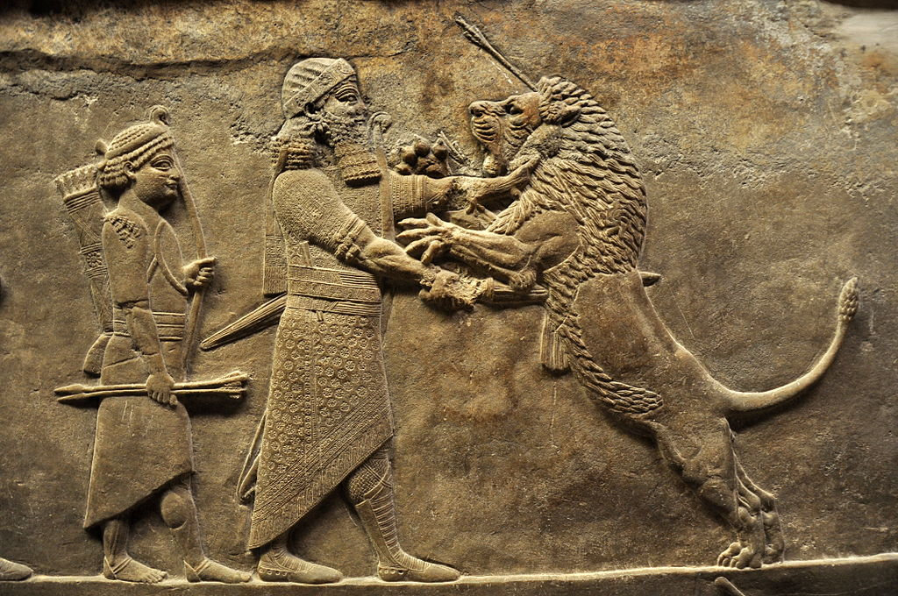

Slide 73
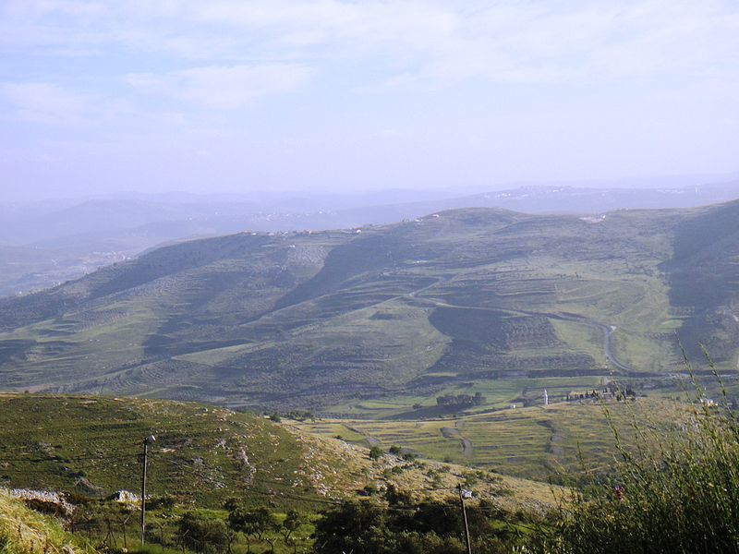

Slide 74
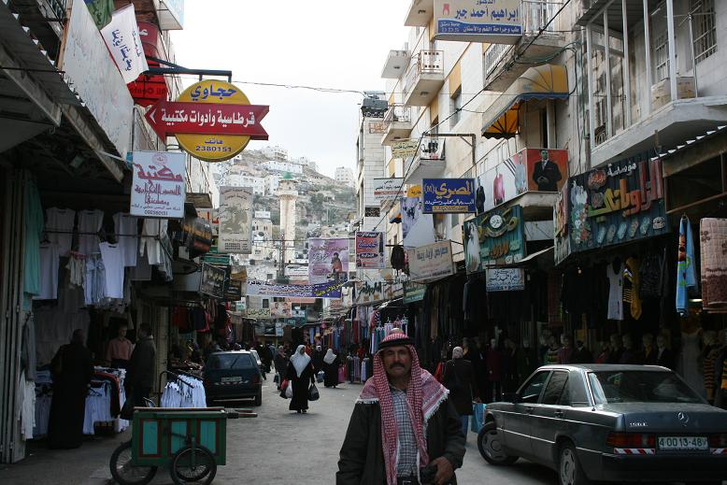

Slide 75
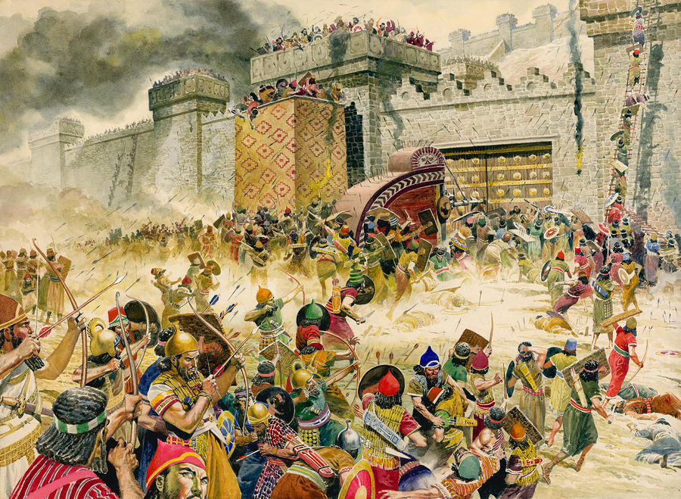

Slide 76
John 4:5-42
22 After these things Jesus and His disciples came into the land of Judea, and there He remained with them and baptized.
23 Now John also was baptizing in Aenon near Salim, because there was much water there. And they came and were baptized.
24 For John had not yet been thrown into prison.
25 Then there arose a dispute between some of John’s disciples and the Jews about purification.
26 And they came to John and said to him, “Rabbi, He who was with you beyond the Jordan, to whom you have testified—behold, He is baptizing, and all are coming to Him!”
27 John answered and said, “A man can receive nothing unless it has been given to him from heaven.
28 “You yourselves bear me witness, that I said, ‘I am not the Christ,’ but, ‘I have been sent before Him.’
29 “He who has the bride is the bridegroom; but the friend of the bridegroom, who stands and hears him, rejoices greatly because of the bridegroom’s voice. Therefore this joy of mine is fulfilled.
30 “He must increase, but I must decrease.
31 “He who comes from above is above all; he who is of the earth is earthly and speaks of the earth. He who comes from heaven is above all.
32 “And what He has seen and heard, that He testifies; and no one receives His testimony.
33 “He who has received His testimony has certified that God is true.
34 “For He whom God has sent speaks the words of God, for God does not give the Spirit by measure.
35 “The Father loves the Son, and has given all things into His hand.
36 “He who believes in the Son has everlasting life; and he who does not believe the Son shall not see life, but the wrath of God abides on him.”
John 4:1-4
4:1 Therefore, when the Lord knew that the Pharisees had heard that Jesus made and baptized more disciples than John
2 (though Jesus Himself did not baptize, but His disciples),
3 He left Judea and departed again to Galilee.
4 But He needed to go through Samaria.
John 4:5-42
5 So He came to a city of Samaria which is called Sychar, near the plot of ground that Jacob gave to his son Joseph.
6 Now Jacob’s well was there. Jesus therefore, being wearied from His journey, sat thus by the well. It was about the sixth hour.
7 A woman of Samaria came to draw water. Jesus said to her, “Give Me a drink.”
8 For His disciples had gone away into the city to buy food.
9 Then the woman of Samaria said to Him, “How is it that You, being a Jew, ask a drink from me, a Samaritan woman?” For Jews have no dealings with Samaritans.
10 Jesus answered and said to her, “If you knew the gift of God, and who it is who says to you, ‘Give Me a drink,’ you would have asked Him, and He would have given you living water.”
11 The woman said to Him, “Sir, You have nothing to draw with, and the well is deep. Where then do You get that living water?
12 “Are You greater than our father Jacob, who gave us the well, and drank from it himself, as well as his sons and his livestock?”
13 Jesus answered and said to her, “Whoever drinks of this water will thirst again,
14 “but whoever drinks of the water that I shall give him will never thirst. But the water that I shall give him will become in him a fountain of water springing up into everlasting life.”
15 The woman said to Him, “Sir, give me this water, that I may not thirst, nor come here to draw.”
16 Jesus said to her, “Go, call your husband, and come here.”
17 The woman answered and said, “I have no husband.” Jesus said to her, “You have well said, ‘I have no husband,’
18 “for you have had five husbands, and the one whom you now have is not your husband; in that you spoke truly.”
19 The woman said to Him, “Sir, I perceive that You are a prophet.
20 “Our fathers worshiped on this mountain, and you Jews say that in Jerusalem is the place where one ought to worship.”
21 Jesus said to her, “Woman, believe Me, the hour is coming when you will neither on this mountain, nor in Jerusalem, worship the Father.
22 “You worship what you do not know; we know what we worship, for salvation is of the Jews.
23 “But the hour is coming, and now is, when the true worshipers will worship the Father in spirit and truth; for the Father is seeking such to worship Him.
24 “God is Spirit, and those who worship Him must worship in spirit and truth.”
25 The woman said to Him, “I know that Messiah is coming” (who is called Christ). “When He comes, He will tell us all things.”
26 Jesus said to her, “I who speak to you am He.”
27 And at this point His disciples came, and they marveled that He talked with a woman; yet no one said, “What do You seek?” or, “Why are You talking with her?”
28 The woman then left her waterpot, went her way into the city, and said to the men,
29 “Come, see a Man who told me all things that I ever did. Could this be the Christ?”
30 Then they went out of the city and came to Him.
31 In the meantime His disciples urged Him, saying, “Rabbi, eat.”
32 But He said to them, “I have food to eat of which you do not know.”
33 Therefore the disciples said to one another, “Has anyone brought Him anything to eat?”
34 Jesus said to them, “My food is to do the will of Him who sent Me, and to finish His work.
35 “Do you not say, ‘There are still four months and then comes the harvest’? Behold, I say to you, lift up your eyes and look at the fields, for they are already white for harvest!
36 “And he who reaps receives wages, and gathers fruit for eternal life, that both he who sows and he who reaps may rejoice together.
37 “For in this the saying is true: ‘One sows and another reaps.’
38 “I sent you to reap that for which you have not labored; others have labored, and you have entered into their labors.”
39 And many of the Samaritans of that city believed in Him because of the word of the woman who testified, “He told me all that I ever did.”
40 So when the Samaritans had come to Him, they urged Him to stay with them; and He stayed there two days.
41 And many more believed because of His own word.
42 Then they said to the woman, “Now we believe, not because of what you said, for we ourselves have heard Him and we know that this is indeed the Christ, the Savior of the world.”

Slide 77
John 4:5-42
22 After these things Jesus and His disciples came into the land of Judea, and there He remained with them and baptized.
23 Now John also was baptizing in Aenon near Salim, because there was much water there. And they came and were baptized.
24 For John had not yet been thrown into prison.
25 Then there arose a dispute between some of John’s disciples and the Jews about purification.
26 And they came to John and said to him, “Rabbi, He who was with you beyond the Jordan, to whom you have testified—behold, He is baptizing, and all are coming to Him!”
27 John answered and said, “A man can receive nothing unless it has been given to him from heaven.
28 “You yourselves bear me witness, that I said, ‘I am not the Christ,’ but, ‘I have been sent before Him.’
29 “He who has the bride is the bridegroom; but the friend of the bridegroom, who stands and hears him, rejoices greatly because of the bridegroom’s voice. Therefore this joy of mine is fulfilled.
30 “He must increase, but I must decrease.
31 “He who comes from above is above all; he who is of the earth is earthly and speaks of the earth. He who comes from heaven is above all.
32 “And what He has seen and heard, that He testifies; and no one receives His testimony.
33 “He who has received His testimony has certified that God is true.
34 “For He whom God has sent speaks the words of God, for God does not give the Spirit by measure.
35 “The Father loves the Son, and has given all things into His hand.
36 “He who believes in the Son has everlasting life; and he who does not believe the Son shall not see life, but the wrath of God abides on him.”
John 4:1-4
4:1 Therefore, when the Lord knew that the Pharisees had heard that Jesus made and baptized more disciples than John
2 (though Jesus Himself did not baptize, but His disciples),
3 He left Judea and departed again to Galilee.
4 But He needed to go through Samaria.
John 4:5-42
5 So He came to a city of Samaria which is called Sychar, near the plot of ground that Jacob gave to his son Joseph.
6 Now Jacob’s well was there. Jesus therefore, being wearied from His journey, sat thus by the well. It was about the sixth hour.
7 A woman of Samaria came to draw water. Jesus said to her, “Give Me a drink.”
8 For His disciples had gone away into the city to buy food.
9 Then the woman of Samaria said to Him, “How is it that You, being a Jew, ask a drink from me, a Samaritan woman?” For Jews have no dealings with Samaritans.
10 Jesus answered and said to her, “If you knew the gift of God, and who it is who says to you, ‘Give Me a drink,’ you would have asked Him, and He would have given you living water.”
11 The woman said to Him, “Sir, You have nothing to draw with, and the well is deep. Where then do You get that living water?
12 “Are You greater than our father Jacob, who gave us the well, and drank from it himself, as well as his sons and his livestock?”
13 Jesus answered and said to her, “Whoever drinks of this water will thirst again,
14 “but whoever drinks of the water that I shall give him will never thirst. But the water that I shall give him will become in him a fountain of water springing up into everlasting life.”
15 The woman said to Him, “Sir, give me this water, that I may not thirst, nor come here to draw.”
16 Jesus said to her, “Go, call your husband, and come here.”
17 The woman answered and said, “I have no husband.” Jesus said to her, “You have well said, ‘I have no husband,’
18 “for you have had five husbands, and the one whom you now have is not your husband; in that you spoke truly.”
19 The woman said to Him, “Sir, I perceive that You are a prophet.
20 “Our fathers worshiped on this mountain, and you Jews say that in Jerusalem is the place where one ought to worship.”
21 Jesus said to her, “Woman, believe Me, the hour is coming when you will neither on this mountain, nor in Jerusalem, worship the Father.
22 “You worship what you do not know; we know what we worship, for salvation is of the Jews.
23 “But the hour is coming, and now is, when the true worshipers will worship the Father in spirit and truth; for the Father is seeking such to worship Him.
24 “God is Spirit, and those who worship Him must worship in spirit and truth.”
25 The woman said to Him, “I know that Messiah is coming” (who is called Christ). “When He comes, He will tell us all things.”
26 Jesus said to her, “I who speak to you am He.”
27 And at this point His disciples came, and they marveled that He talked with a woman; yet no one said, “What do You seek?” or, “Why are You talking with her?”
28 The woman then left her waterpot, went her way into the city, and said to the men,
29 “Come, see a Man who told me all things that I ever did. Could this be the Christ?”
30 Then they went out of the city and came to Him.
31 In the meantime His disciples urged Him, saying, “Rabbi, eat.”
32 But He said to them, “I have food to eat of which you do not know.”
33 Therefore the disciples said to one another, “Has anyone brought Him anything to eat?”
34 Jesus said to them, “My food is to do the will of Him who sent Me, and to finish His work.
35 “Do you not say, ‘There are still four months and then comes the harvest’? Behold, I say to you, lift up your eyes and look at the fields, for they are already white for harvest!
36 “And he who reaps receives wages, and gathers fruit for eternal life, that both he who sows and he who reaps may rejoice together.
37 “For in this the saying is true: ‘One sows and another reaps.’
38 “I sent you to reap that for which you have not labored; others have labored, and you have entered into their labors.”
39 And many of the Samaritans of that city believed in Him because of the word of the woman who testified, “He told me all that I ever did.”
40 So when the Samaritans had come to Him, they urged Him to stay with them; and He stayed there two days.
41 And many more believed because of His own word.
42 Then they said to the woman, “Now we believe, not because of what you said, for we ourselves have heard Him and we know that this is indeed the Christ, the Savior of the world.”

Slide 78
John 4:5-42
22 After these things Jesus and His disciples came into the land of Judea, and there He remained with them and baptized.
23 Now John also was baptizing in Aenon near Salim, because there was much water there. And they came and were baptized.
24 For John had not yet been thrown into prison.
25 Then there arose a dispute between some of John’s disciples and the Jews about purification.
26 And they came to John and said to him, “Rabbi, He who was with you beyond the Jordan, to whom you have testified—behold, He is baptizing, and all are coming to Him!”
27 John answered and said, “A man can receive nothing unless it has been given to him from heaven.
28 “You yourselves bear me witness, that I said, ‘I am not the Christ,’ but, ‘I have been sent before Him.’
29 “He who has the bride is the bridegroom; but the friend of the bridegroom, who stands and hears him, rejoices greatly because of the bridegroom’s voice. Therefore this joy of mine is fulfilled.
30 “He must increase, but I must decrease.
31 “He who comes from above is above all; he who is of the earth is earthly and speaks of the earth. He who comes from heaven is above all.
32 “And what He has seen and heard, that He testifies; and no one receives His testimony.
33 “He who has received His testimony has certified that God is true.
34 “For He whom God has sent speaks the words of God, for God does not give the Spirit by measure.
35 “The Father loves the Son, and has given all things into His hand.
36 “He who believes in the Son has everlasting life; and he who does not believe the Son shall not see life, but the wrath of God abides on him.”
John 4:1-4
4:1 Therefore, when the Lord knew that the Pharisees had heard that Jesus made and baptized more disciples than John
2 (though Jesus Himself did not baptize, but His disciples),
3 He left Judea and departed again to Galilee.
4 But He needed to go through Samaria.
John 4:5-42
5 So He came to a city of Samaria which is called Sychar, near the plot of ground that Jacob gave to his son Joseph.
6 Now Jacob’s well was there. Jesus therefore, being wearied from His journey, sat thus by the well. It was about the sixth hour.
7 A woman of Samaria came to draw water. Jesus said to her, “Give Me a drink.”
8 For His disciples had gone away into the city to buy food.
9 Then the woman of Samaria said to Him, “How is it that You, being a Jew, ask a drink from me, a Samaritan woman?” For Jews have no dealings with Samaritans.
10 Jesus answered and said to her, “If you knew the gift of God, and who it is who says to you, ‘Give Me a drink,’ you would have asked Him, and He would have given you living water.”
11 The woman said to Him, “Sir, You have nothing to draw with, and the well is deep. Where then do You get that living water?
12 “Are You greater than our father Jacob, who gave us the well, and drank from it himself, as well as his sons and his livestock?”
13 Jesus answered and said to her, “Whoever drinks of this water will thirst again,
14 “but whoever drinks of the water that I shall give him will never thirst. But the water that I shall give him will become in him a fountain of water springing up into everlasting life.”
15 The woman said to Him, “Sir, give me this water, that I may not thirst, nor come here to draw.”
16 Jesus said to her, “Go, call your husband, and come here.”
17 The woman answered and said, “I have no husband.” Jesus said to her, “You have well said, ‘I have no husband,’
18 “for you have had five husbands, and the one whom you now have is not your husband; in that you spoke truly.”
19 The woman said to Him, “Sir, I perceive that You are a prophet.
20 “Our fathers worshiped on this mountain, and you Jews say that in Jerusalem is the place where one ought to worship.”
21 Jesus said to her, “Woman, believe Me, the hour is coming when you will neither on this mountain, nor in Jerusalem, worship the Father.
22 “You worship what you do not know; we know what we worship, for salvation is of the Jews.
23 “But the hour is coming, and now is, when the true worshipers will worship the Father in spirit and truth; for the Father is seeking such to worship Him.
24 “God is Spirit, and those who worship Him must worship in spirit and truth.”
25 The woman said to Him, “I know that Messiah is coming” (who is called Christ). “When He comes, He will tell us all things.”
26 Jesus said to her, “I who speak to you am He.”
27 And at this point His disciples came, and they marveled that He talked with a woman; yet no one said, “What do You seek?” or, “Why are You talking with her?”
28 The woman then left her waterpot, went her way into the city, and said to the men,
29 “Come, see a Man who told me all things that I ever did. Could this be the Christ?”
30 Then they went out of the city and came to Him.
31 In the meantime His disciples urged Him, saying, “Rabbi, eat.”
32 But He said to them, “I have food to eat of which you do not know.”
33 Therefore the disciples said to one another, “Has anyone brought Him anything to eat?”
34 Jesus said to them, “My food is to do the will of Him who sent Me, and to finish His work.
35 “Do you not say, ‘There are still four months and then comes the harvest’? Behold, I say to you, lift up your eyes and look at the fields, for they are already white for harvest!
36 “And he who reaps receives wages, and gathers fruit for eternal life, that both he who sows and he who reaps may rejoice together.
37 “For in this the saying is true: ‘One sows and another reaps.’
38 “I sent you to reap that for which you have not labored; others have labored, and you have entered into their labors.”
39 And many of the Samaritans of that city believed in Him because of the word of the woman who testified, “He told me all that I ever did.”
40 So when the Samaritans had come to Him, they urged Him to stay with them; and He stayed there two days.
41 And many more believed because of His own word.
42 Then they said to the woman, “Now we believe, not because of what you said, for we ourselves have heard Him and we know that this is indeed the Christ, the Savior of the world.”

Slide 79
John 3:22-36
22 After these things Jesus and His disciples came into the land of Judea, and there He remained with them and baptized.
23 Now John also was baptizing in Aenon near Salim, because there was much water there. And they came and were baptized.
24 For John had not yet been thrown into prison.
25 Then there arose a dispute between some of John’s disciples and the Jews about purification.
26 And they came to John and said to him, “Rabbi, He who was with you beyond the Jordan, to whom you have testified—behold, He is baptizing, and all are coming to Him!”
27 John answered and said, “A man can receive nothing unless it has been given to him from heaven.
28 “You yourselves bear me witness, that I said, ‘I am not the Christ,’ but, ‘I have been sent before Him.’
29 “He who has the bride is the bridegroom; but the friend of the bridegroom, who stands and hears him, rejoices greatly because of the bridegroom’s voice. Therefore this joy of mine is fulfilled.
30 “He must increase, but I must decrease.
31 “He who comes from above is above all; he who is of the earth is earthly and speaks of the earth. He who comes from heaven is above all.
32 “And what He has seen and heard, that He testifies; and no one receives His testimony.
33 “He who has received His testimony has certified that God is true.
34 “For He whom God has sent speaks the words of God, for God does not give the Spirit by measure.
35 “The Father loves the Son, and has given all things into His hand.
36 “He who believes in the Son has everlasting life; and he who does not believe the Son shall not see life, but the wrath of God abides on him.”
John 4:1-4
4:1 Therefore, when the Lord knew that the Pharisees had heard that Jesus made and baptized more disciples than John
2 (though Jesus Himself did not baptize, but His disciples),
3 He left Judea and departed again to Galilee.
4 But He needed to go through Samaria.
John 4:5-42
5 So He came to a city of Samaria which is called Sychar, near the plot of ground that Jacob gave to his son Joseph.
6 Now Jacob’s well was there. Jesus therefore, being wearied from His journey, sat thus by the well. It was about the sixth hour.
7 A woman of Samaria came to draw water. Jesus said to her, “Give Me a drink.”
8 For His disciples had gone away into the city to buy food.
9 Then the woman of Samaria said to Him, “How is it that You, being a Jew, ask a drink from me, a Samaritan woman?” For Jews have no dealings with Samaritans.
10 Jesus answered and said to her, “If you knew the gift of God, and who it is who says to you, ‘Give Me a drink,’ you would have asked Him, and He would have given you living water.”
11 The woman said to Him, “Sir, You have nothing to draw with, and the well is deep. Where then do You get that living water?
12 “Are You greater than our father Jacob, who gave us the well, and drank from it himself, as well as his sons and his livestock?”
13 Jesus answered and said to her, “Whoever drinks of this water will thirst again,
14 “but whoever drinks of the water that I shall give him will never thirst. But the water that I shall give him will become in him a fountain of water springing up into everlasting life.”
15 The woman said to Him, “Sir, give me this water, that I may not thirst, nor come here to draw.”
16 Jesus said to her, “Go, call your husband, and come here.”
17 The woman answered and said, “I have no husband.” Jesus said to her, “You have well said, ‘I have no husband,’
18 “for you have had five husbands, and the one whom you now have is not your husband; in that you spoke truly.”
19 The woman said to Him, “Sir, I perceive that You are a prophet.
20 “Our fathers worshiped on this mountain, and you Jews say that in Jerusalem is the place where one ought to worship.”
21 Jesus said to her, “Woman, believe Me, the hour is coming when you will neither on this mountain, nor in Jerusalem, worship the Father.
22 “You worship what you do not know; we know what we worship, for salvation is of the Jews.
23 “But the hour is coming, and now is, when the true worshipers will worship the Father in spirit and truth; for the Father is seeking such to worship Him.
24 “God is Spirit, and those who worship Him must worship in spirit and truth.”
25 The woman said to Him, “I know that Messiah is coming” (who is called Christ). “When He comes, He will tell us all things.”
26 Jesus said to her, “I who speak to you am He.”
27 And at this point His disciples came, and they marveled that He talked with a woman; yet no one said, “What do You seek?” or, “Why are You talking with her?”
28 The woman then left her waterpot, went her way into the city, and said to the men,
29 “Come, see a Man who told me all things that I ever did. Could this be the Christ?”
30 Then they went out of the city and came to Him.
31 In the meantime His disciples urged Him, saying, “Rabbi, eat.”
32 But He said to them, “I have food to eat of which you do not know.”
33 Therefore the disciples said to one another, “Has anyone brought Him anything to eat?”
34 Jesus said to them, “My food is to do the will of Him who sent Me, and to finish His work.
35 “Do you not say, ‘There are still four months and then comes the harvest’? Behold, I say to you, lift up your eyes and look at the fields, for they are already white for harvest!
36 “And he who reaps receives wages, and gathers fruit for eternal life, that both he who sows and he who reaps may rejoice together.
37 “For in this the saying is true: ‘One sows and another reaps.’
38 “I sent you to reap that for which you have not labored; others have labored, and you have entered into their labors.”
39 And many of the Samaritans of that city believed in Him because of the word of the woman who testified, “He told me all that I ever did.”
40 So when the Samaritans had come to Him, they urged Him to stay with them; and He stayed there two days.
41 And many more believed because of His own word.
42 Then they said to the woman, “Now we believe, not because of what you said, for we ourselves have heard Him and we know that this is indeed the Christ, the Savior of the world.”

Slide 80
Philippians 2:5-8 (ESV)
5 Have this mind among yourselves, which is yours in Christ Jesus,
6 who, though he was in the form of God, did not count equality with God a thing to be grasped,
7 but emptied himself, by taking the form of a servant, being born in the likeness of men.
8 And being found in human form, he humbled himself by becoming obedient to the point of death, even death on a cross.

Slide 81
John 2:23-3:21
16 “For God so loved the world that He gave His only begotten Son, that whoever believes in Him should not perish but have everlasting life.
17 “For God did not send His Son into the world to condemn the world, but that the world through Him might be saved.

Slide 82
Shechem in biblical history:
• Abraham built and altar and was promised the land there (Genesis 12:6-7)
• Jacob (Israel) lived and built and altar there (Genesis 33:18-20)
• Simeon and Levi killed the men of Shechem after Dinah was raped (Genesis 34)
• Joseph came to Shechem looking for his brothers and they sold him not far from there (Genesis 37)
• Joseph’s bones were taken from Egypt and buried at Shechem (Joshua 24:32)
• The Israelites shouted the blessings and cursings from Mt. Ebal and Gerazim there (Deuteronomy 27:11-26; Joshua 8:33-35)
• Joshua gave his last words to Israel there (Joshua 24)
• Shechem became the first capital of Jeroboam and the northern 10 tribes (1 Kings 12:25)

Slide 83
John 2:23-3:21
18 “He who believes in Him is not condemned; but he who does not believe is condemned already, because he has not believed in the name of the only begotten Son of God.
19 “And this is the condemnation, that the light has come into the world, and men loved darkness rather than light, because their deeds were evil.

Slide 84
